Slide 1
Data Structure and Algorithms
Azaz Ahmed Kiani

Slide 2
Circular Queue Lesson 16
2

Slide 3
Array Implementation (Linear Queue Problem)
5
4
6
7
8
7
6
0 1 2 3 4 5 6 7 8
Front=0
Rear=6
8
7
6
0 1 2 3 4 5 6 7 8
Front=4
Rear=6
7
6
12
67
0 1 2 3 4 5 6 7 8
Front=5
Rear=8
How can we insert more elements? Rear index can not move beyond the last element….

Slide 4
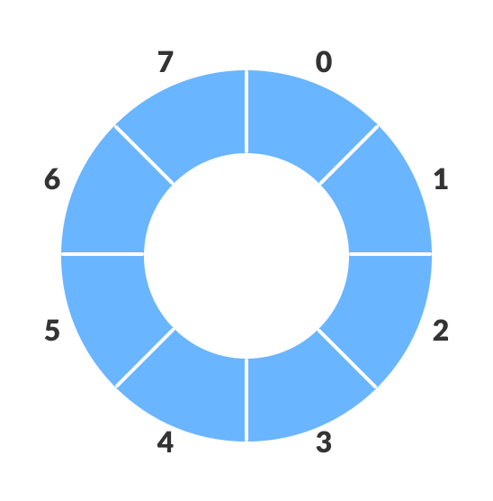
Solution: Using circular queue
Allow rear to wrap around the array.
use module arithmetic
rear = (rear + 1) % queueSize;

Slide 5
Circular Queue
7
6
12
67
0 1 2 3 4 5 6 7 8
Front=5
Rear=8
Enqueue 39 Rear=(Rear+1) mod Queue Size = (8+1) mod 9 = 0
39
7
6
12
67
0 1 2 3 4 5 6 7 8
Front=5
Rear=0

Slide 6

Circular Queue - Array
The First position follows the last
The queue is found somewhere around the circle in consecutive positions
QUEUE [l] comes after QUEUE [N] in the array
Suppose that our queue contains only one element, i.e.,
If element is deleted. Then we assign
FRONT:= NULL and
REAR: = NULL to indicate that the queue is empty

Slide 7
Circular Queue - Array
1
maxlength
2
.
.
.
.
.
Rear
Front
queue

Slide 8
Circular Queue - Array
If Queue is Full and there are spaces available in the Insert ITEM into the queue by assigning ITEM to QUEUE [l].
Specifically, instead of increasing REAR to N + 1, we reset REAR = 1 and then assign
QUEUE [REAR]: = ITEM
Similarly, if FRONT = N and an element of QUEUE is deleted
Reset FRONT = 1 instead of increasing FRONT to N + 1

Slide 9
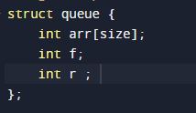
Circular Queue Implementation: Step 1

Slide 10
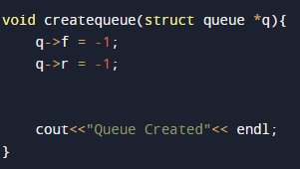
Step 2: Create Circular Queue

Slide 11
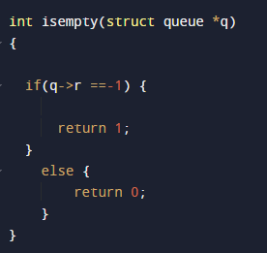
Step 3: IsEmpty()…?

Slide 12
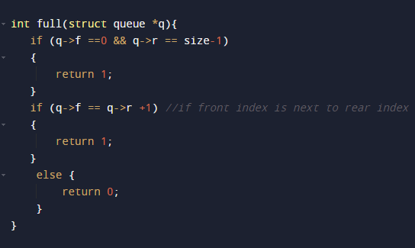
Step 4: IsFull()…?

Slide 13
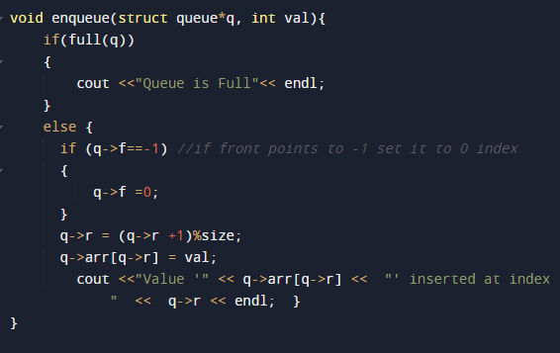
Step 5: Enqueue

Slide 14
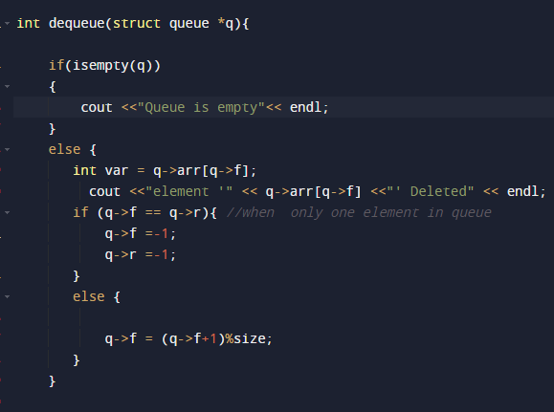
Step 6: dequeue

Slide 15
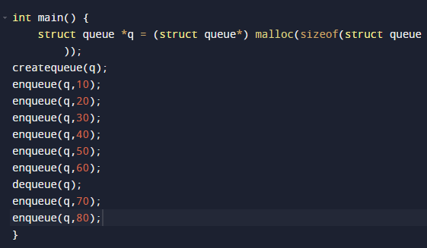
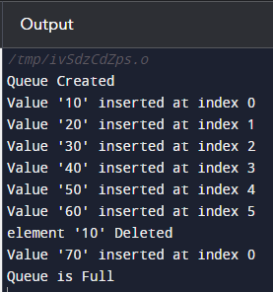
Step 7: Main function

